Slide 1
Lecture 14: Time Response (part III)
Review second-order systems
Experimental determination (system ID)
Higher-order systems
Reduced-order models
Effect of zeros

Slide 2
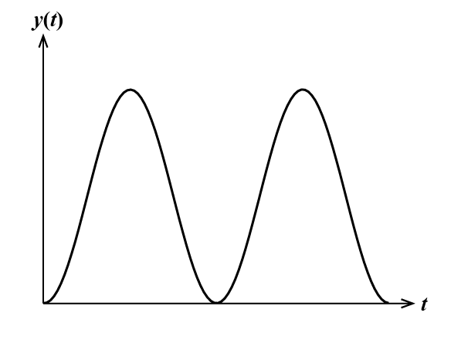
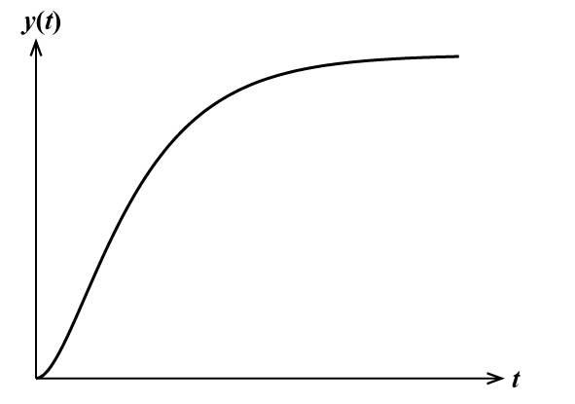
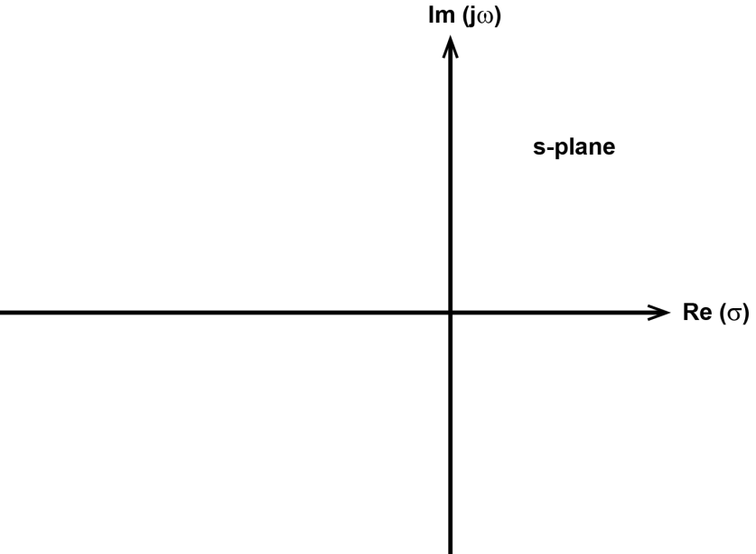
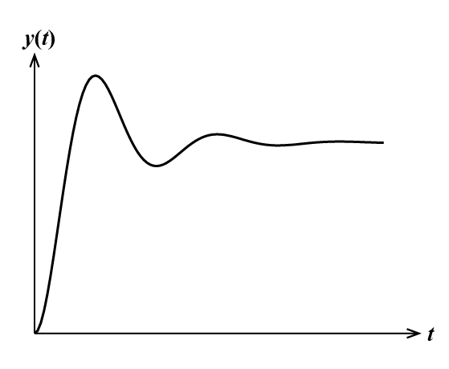
Second-Order Systems
x
x
(ζ = 0) undamped
(ζ = 1) crit damped
x
x
x
x
x
x
(0< ζ < 1) underdamped
(ζ > 1) overdamped

Slide 3
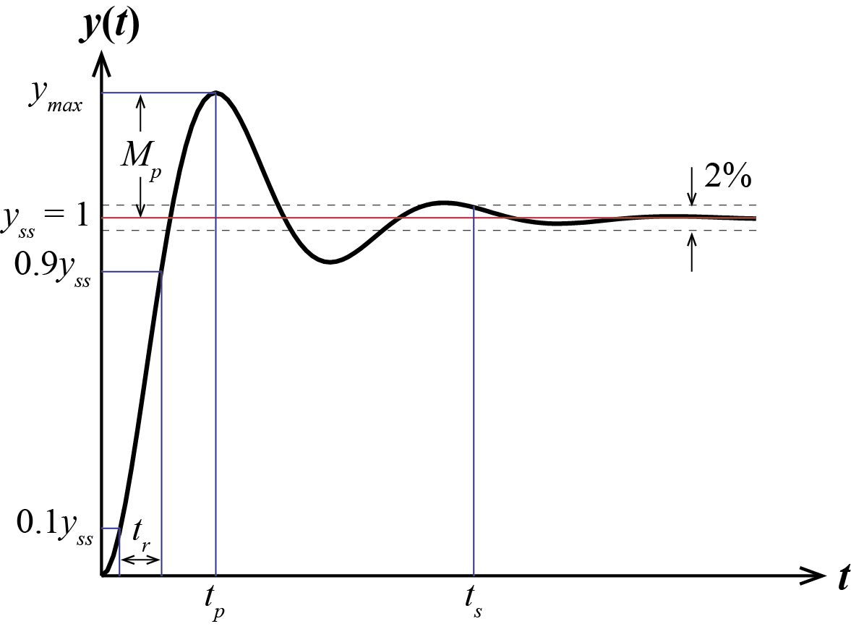
Second-Order Systems
Underdamped step response (u(t) = 1(t))
Notes:
Replace with Ogata Figure 10-21 … Draw on Board so can refer to?

Slide 4
Experimental Determination
x(t)
Free response graph of an underdamped 2nd-order system can be used to determine ω_{d} and σ (or ω_{n} and ζ)
t

Slide 5
Experimental Determination
x₁
x₂
x₃
t₁
t₂
t₃
This is referred to as the logarithmic decrement

Slide 6
Experimental Determination
Note that the logarithmic decrement is determined solely by ζ
Considering multiple periods improves the estimate

Slide 7
Example
Identify ω_{d}, σ, ω_{n}, and ζ assuming the following is the free response of a canonical 2nd-order system
Notes:
Find generic second order differential equation, then find physical parameter values … that’s why called system identification … driveline?

Slide 8
Example
If the previous response was for a mass-spring-damper system with m = 2kg, identify b and k

Slide 9
Higher-Order Systems
Higher-order systems (more than two poles) can be considered as the sum of 1st- and 2nd-order responses
Exact time response can be determined by partial fraction expansion
Ex:
Higher-order systems can often be approximated by 1st- or 2nd-order models

Slide 10
Model Reduction
Ex:
If one pole is much slower than another, it will dominate the dynamic response
10
s + 10
2
s + 2
Non-Canonical Systems

Slide 11
Model Reduction
Rule of thumb: the dynamics of a pole may be neglected if its real part is 5 times greater than the real part of the other poles
Its steady-state contribution must still be accounted for though (replace by a static gain)
pole at -2 dominates
the pole at -10

Slide 12
Model Reduction
Need K so that G(s) and G_{red}(s) have same steady-state value
For G(s), DC gain = G(0) = 1
To achieve G_{red}(0) = 1, need K = 2 →

Slide 13
Effect of Zeros
Zeros are values of s that make numerator equal 0
Interpretation #1
Zeros affect the contribution of each pole, that is, the coefficients of the partial fraction expansion
whereas
Notes:
Seen the meaning of poles

Slide 14
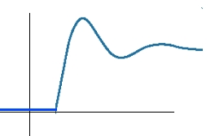
Effect of Zeros
Interpretation #2
derivative of
system without zero
system
without zero

Slide 15
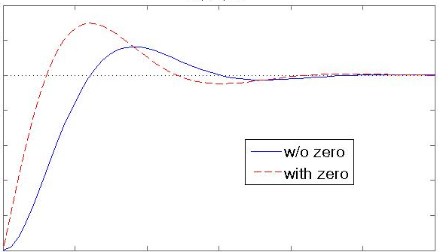
Effect of Zeros
Zeros tend to have the effect of increasing overshoot and decreasing rise/peak time
y(t)
t

Slide 16
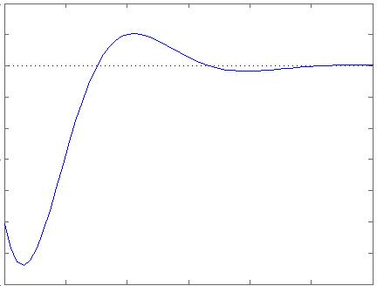
Effect of Zeros
If zero has positive real part, then the response will initially move in the reverse direction, called a nonminimum phase zero
y(t)
t

Slide 17
Effect of Zeros
An exception to the preceding rules is when a zero is near a pole
Example:
If z = p, then pole and zero cancel
exactly and
If z ≈ p, then effect of pole and zero
are minimal and
Notes:
Be careful of doing this on purpose

